Slide 1
UTSA Student Branch Phase I Funding Fall 2018
IEEE Central Texas Section
August 25, 2018
San Marcos, Texas
Branch Advisor: Dr. Paul Morton - Paul.Morton@utsa.edu

Slide 2
Student Branch Overview
Largest active student engineering organization at UTSA
Integral part of College of Engineering student activities
Leadership Team: (14 officers)
Position | Name | Email Address
Chairman | Jessica Vaquera | rrm701@my.utsa.edu
Vice Chairman | Josue Alcaraz | vom101@my.utsa.edu
HKN President | Michael Palacios | hkn.utsa@gmail.com
HKN Vice President | Allen Herrera | pwj365@gmail.com
Robotics Chairman | Alexander Ibarra | robotics.utsa@gmail.com

Slide 3
Past Utilization of CTS Funding Phase I & II Funding accomplishments from 2018:
Student Interest Groups (R5 Robotics) [$800]
Social Engagement (Student Branch) [$200]

Slide 4
Branch Goals Requested amount for Phase I 2018: $1000
Region5 Robotics Competition [$500]
HKN Workshops [$200]
Robotics Automation Society Workshops [$300]

Slide 5
Branch Goals
Region5 Conference
Compete in R5 Robotics competition
Increase student presence at conference (~25 attendees)
FE Workshop
Prepare students for the FE Exam
Bring speakers from industry to give insight for students.

Slide 6
Robotics Student Interest Group [$500]
Current Standing
Primarily focused on Region5 competition
Holding workshops to teach members Python, Linux, ROS and OpenCV
Collaboration with Brandeis High School to recruit new members and prepare high schoolers for careers in robotics

Slide 7
HKN Student Interest Group [$200]
Soldering Workshop
18 soldering stations in need of maintenance
Serve 100+ students annually
Industry Speaking Events
Professional Networking
Membership Benefits
Cohosting two events with Tau Beta Pi
Highschool Outreach
Hosting soldering workshops for 20+ students

Slide 8
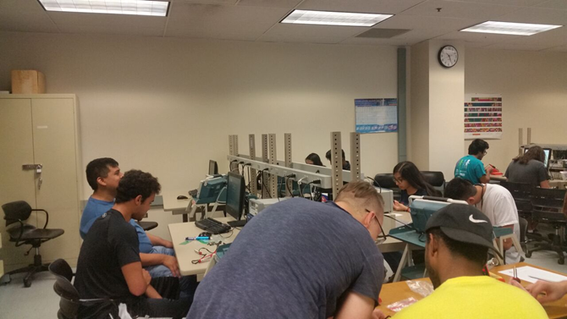
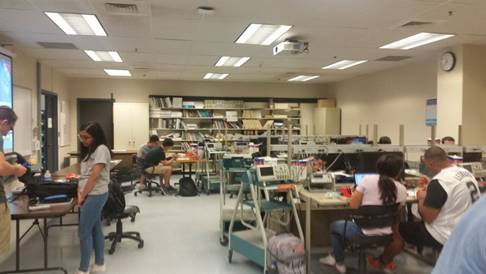
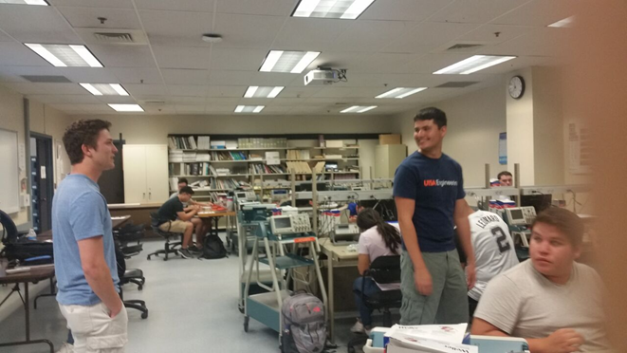
HKN Soldering Workshop

Slide 9
Branch Goals Requested amount for Phase II 2018: $1500+
Region5 Robotics Competition [$1000+]
IEEE Promotional Materials [$200+]
HKN workshops[$200]

Slide 10
Questions?

